Slide 1
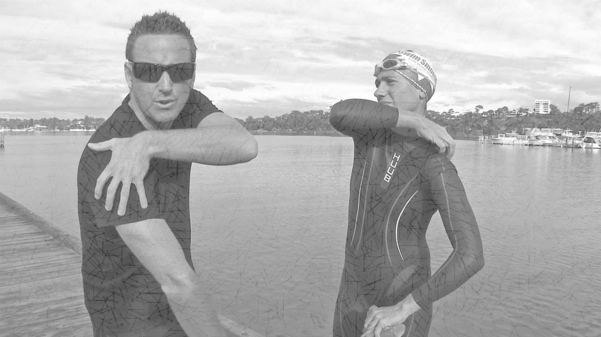
A change of clothes Colossians 3:7-11

Slide 2
A change of clothes Colossians 3:7-11
Uniforms

Slide 3
A change of clothes Colossians 3:7-11
Uniforms
Master/slave
“Sin shall not be your master, for you are not under law but under grace” (Rom. 6:14).

Slide 4
A change of clothes Colossians 3:7-11
Uniforms
Master/slave
Different lifestyle

Slide 5
A change of clothes Colossians 3:7-11
Uniforms
Master/slave
Different lifestyle
Things to get rid of -
“You must rid yourselves of …anger, rage, malice, slander and filthy language. Do not lie to each other, since you have taken off your old self with its practices and put on the new self, which is being renewed in the image of its Creator. Here there is no Greek or Jew, circumcised or uncircumcised, barbarian, Scythian, slave or free, but Christ is all, and is in all.”

Slide 6
A change of clothes Colossians 3:7-11
Uniforms
Master/slave
Different lifestyle
Things to get rid of…because we can!
“created to be like God in true righteousness and holiness” (Eph.4:24).

Slide 7
A change of clothes Colossians 3:7-11
1. A change of clothes

Slide 8
A change of clothes Colossians 3:7-11
A change of clothes
Sins of temper
Sins of speech
Sins of discrimination

Slide 9
A change of clothes Colossians 3:7-11
A change of clothes
Sins of temper
Anger

Slide 10
A change of clothes Colossians 3:7-11
A change of clothes
Sins of temper
Anger
“When angry, do not sin; do not ever let your wrath (your exasperation, your fury or indignation) last until the sun goes down. Leave no [such] room or foothold for the devil [give no opportunity to him]” (Ephesians 4:26-27)

Slide 11
A change of clothes Colossians 3:7-11
A change of clothes
Sins of temper
Anger
Rage

Slide 12
A change of clothes Colossians 3:7-11
A change of clothes
Sins of temper
Anger
Rage
Malice

Slide 13
A change of clothes Colossians 3:7-11
A change of clothes
Sins of temper
Sins of speech
Slander

Slide 14
A change of clothes Colossians 3:7-11
A change of clothes
Sins of temper
Sins of speech
Slander
Abuse

Slide 15
A change of clothes Colossians 3:7-11
A change of clothes
Sins of temper
Sins of speech
Slander
Abuse
“With the tongue we praise our Lord and Father, and with it we curse men, who have been made in God’s likeness. Out of the same mouth come praise and cursing. My brothers, this should not be” (James 3:3,4,9-10).

Slide 16
A change of clothes Colossians 3:7-11
A change of clothes
Sins of temper
Sins of speech
Slander
Abuse
Lying

Slide 17
A change of clothes Colossians 3:7-11
A change of clothes
Sins of temper
Sins of speech
Slander
Abuse
Lying
Why do we lie?

Slide 18
A change of clothes Colossians 3:7-11
A change of clothes
Sins of temper
Sins of speech
Slander
Abuse
Lying
Why do we lie?
To escape consequences

Slide 19
A change of clothes Colossians 3:7-11
A change of clothes
Sins of temper
Sins of speech
Slander
Abuse
Lying
Why do we lie?
To escape consequences
To promote ourselves

Slide 20
A change of clothes Colossians 3:7-11
A change of clothes
Sins of temper
Sins of speech
Slander
Abuse
Lying
Why tell the truth?

Slide 21
A change of clothes Colossians 3:7-11
A change of clothes
Sins of temper
Sins of speech
Slander
Abuse
Lying
Why tell the truth?
Because the devil is a liar! (John 8:44)

Slide 22
A change of clothes Colossians 3:7-11
A change of clothes
Sins of temper
Sins of speech
Slander
Abuse
Lying
Why tell the truth?
Because the devil is a liar! (John 8:44)
Because we’ve taken off our old self (Col. 3: 9-10)

Slide 23
A change of clothes Colossians 3:7-11
A change of clothes
Sins of temper
Sins of speech
Sins of discrimination

Slide 24
A change of clothes Colossians 3:7-11
A change of clothes
Sins of temper
Sins of speech
Sins of discrimination
Be careful!
Not the same as Galatians 3:28-29 !
“in Christ there is neither Jew nor Greek, slave nor free, male nor female, for you are all one in Christ Jesus. If you belong to Christ, then you are Abraham’s seed, and heirs according to the promise”

Slide 25
A change of clothes Colossians 3:7-11
A change of clothes
Sins of temper
Sins of speech
Sins of discrimination
Context tool
- Circumcised/Uncircumcised – religious
- Barbarian/Scythian – racial & cultural
- Slave/free - social
Colossae

Slide 26
A change of clothes Colossians 3:7-11
A change of clothes
Sins of temper
Sins of speech
Sins of discrimination
No excuses, no hiding behind stereotypes

Slide 27
A change of clothes Colossians 3:7-11
A change of clothes
Sins of temper
Sins of speech
Sins of discrimination
No excuses, no hiding behind stereotypes
Prejudice still exists

Slide 28
A change of clothes Colossians 3:7-11
A change of clothes
Sins of temper
Sins of speech
Sins of discrimination
No excuses, no hiding behind stereotypes
Prejudice still exists
No favouritism
“Suppose a man comes into your meeting wearing a gold ring and fine clothes, and a poor man in filthy old clothes also comes in. If you show special attention to the man wearing fine clothes and say, ‘Here’s a good seat for you,’ but say to the poor man, ‘You stand there’ or ‘Sit on the floor by my feet,’ have you not discriminated among yourselves and become judges with evil thoughts?” (James 2:1-4).

Slide 29
A change of clothes Colossians 3:7-11
A change of clothes
Revolutionary gospel
Demolition of social barriers

Slide 30
A change of clothes Colossians 3:7-11
A change of clothes
Revolutionary gospel
Demolition of social barriers
Grace reaches out to all

Slide 31
A change of clothes Colossians 3:7-11
A change of clothes
Revolutionary gospel
Demolition of social barriers
Grace reaches out to all
Example of Paul

Slide 32
A change of clothes Colossians 3:7-11
A change of clothes
Revolutionary gospel
Putting it into practice

Slide 33
A change of clothes Colossians 3:7-11
A change of clothes
Revolutionary gospel
Putting it into practice
Remember our past

Slide 34
A change of clothes Colossians 3:7-11
A change of clothes
Revolutionary gospel
Putting it into practice
Remember our past
Be bridge builders

Slide 35
A change of clothes Colossians 3:7-11
A change of clothes
Revolutionary gospel
Putting it into practice
Remember our past
Be bridge builders
Be faithful and truthful

